Slide 1
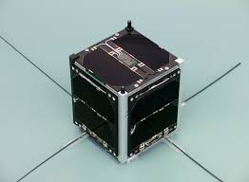
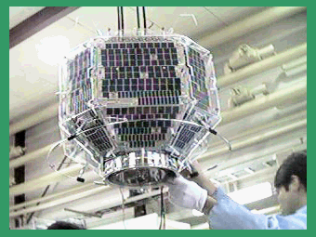
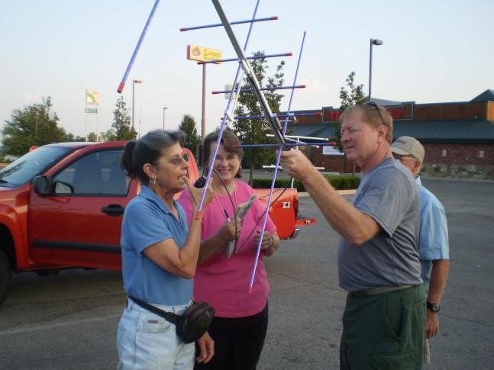
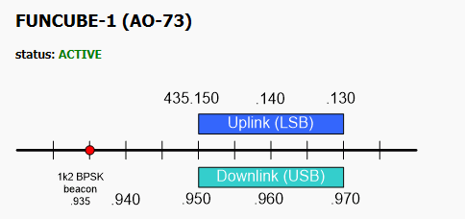
A beginner’s guide to amateur radio satellites
David Bowman G0MRF

Slide 2
Satellite types. – Transponders Repeaters and data
Orbits. Where is it and who can I talk to ?
What do I need? - Radios and antennas
Active satellites / A typical QSO / awards + challenges
Audience participation ! – AO-73 from the car park
David Bowman G0MRF

Slide 3
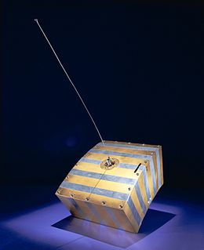
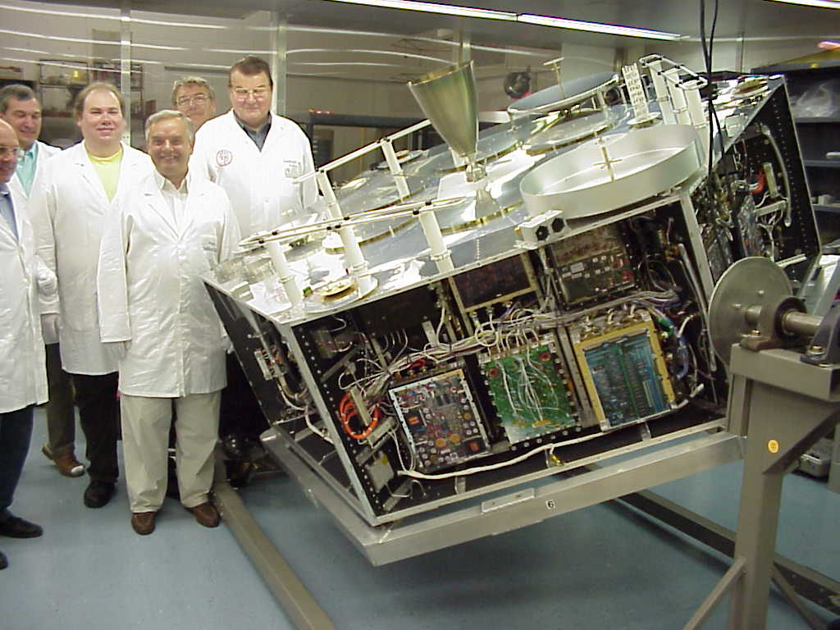
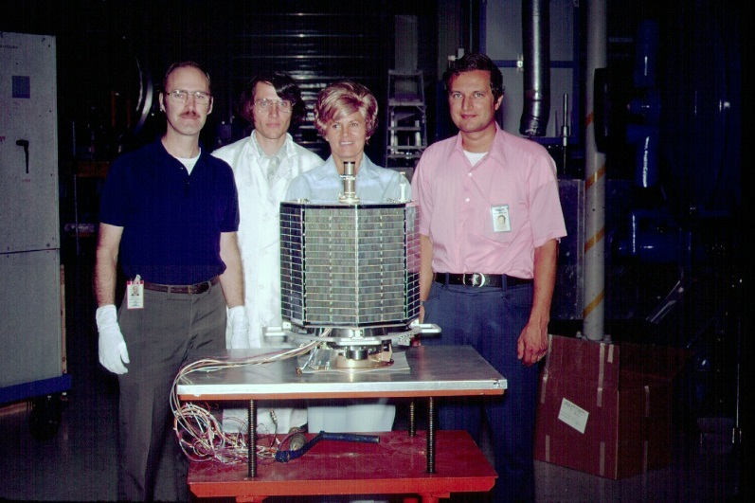
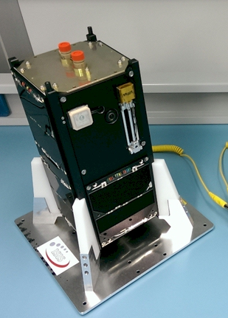
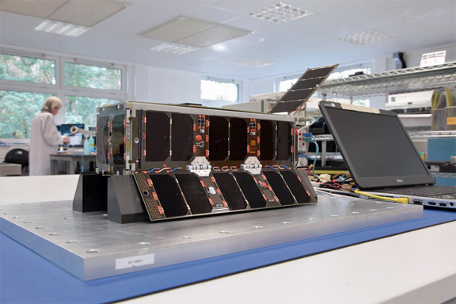
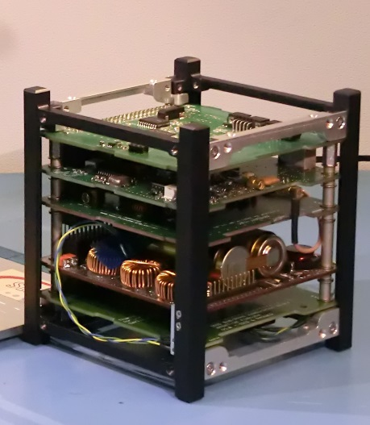
AMSAT Satellites 1962 to 2014
AO-40 2000
AO-7 1974
AO-1 1962
UKube-1 2014
AO-73 2013
EO-79 2014
Notes:
These are a selection of the many AMSAT satellites launched over the years. AO-1 was powered by batteries and transmitted a 140mW beacon on 2m for 22 days, but this was just 5 years after Sputnik.
AO-7 was a typical size of satellite launched between 1970 and the early 1990s, it still works in daylight today. AO-40 was the largest ever produced and provided near world wide coverage from 40,000km+
It was equipped with many transponders from 145 MHz to 24GHz. It even carried a laser communications experiment.
The lower row are the latest trend in affordable satellites. All are CubeSats 3U 1U and 2U in height.

Slide 4

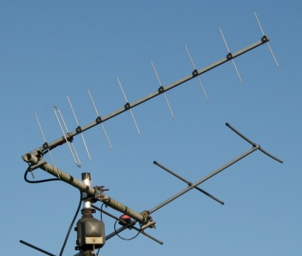
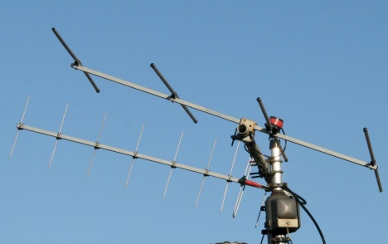
Satellite types. – FM transponders – ( cross band repeaters )
Uplink
Downlink
David Bowman G0MRF

Slide 5
Satellite types. Example SO-50
Uplink 145.850
FM
Downlink 436.860
FM
Mode V/U
David Bowman G0MRF

Slide 6
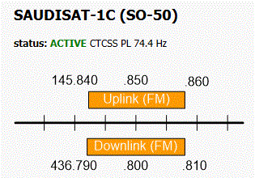
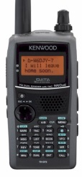
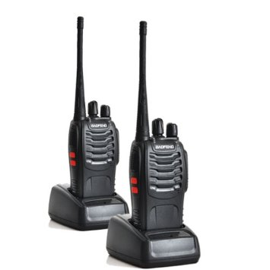
Satellite types. Example SO-50
Power saving :
CTCSS tone 74.4Hz to arm 10 min timer
CTCSS tone 67Hz during QSO
Downlink 436.800 FM
Downlink 436.800 FM
Uplink 145.850 FM
Uplink 145.850 FM
Frequencies +/- Doppler
Notes:
Doppler shift causes the frequency of the signals to change due to the relative motion (speed) between the operator on the ground and the orbiting satellite.
The effect is at a maximum with an overhead pass. (satellite travelling ‘directly’ towards you as it appears over the horizon) Acquisition of signal - AOS
As the satellite approaches, a signal from it transmitted on 436.800 will appear to the operator 9kHz high on 436.809. When overhead or at time of closest approach, it will appear on 436.800.
As the satellite moves away over the horizon at the end of the pass it will appear 9 kHz low on 436.791 MHz
Doppler depends on relative speed and wavelength of the signal.

Slide 7
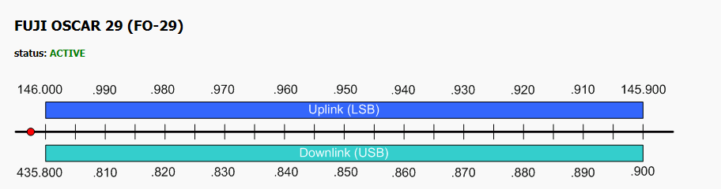
Satellite types. – Linear Transponders
Converts 20kHz - 100kHz of spectrum from one band to another
Allows many QSOs at the same time
Use narrow band modes CW SSB etc.
Usually inverting. Convention is USB on downlink (LSB on uplink)
Doppler shift: At 7.5km per second, Doppler can be +/- 9kHz on 70cm +/- 3kHz on 2m
David Bowman G0MRF

Slide 8
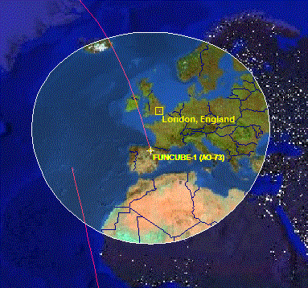
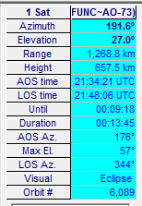
Orbits. Where is the satellite and who can I talk to?
The higher the orbit the larger the communication ‘footprint’
Any stations who are within the satellite footprint can work each other. e.g Iceland to Libya
Low orbit = shorter pass time
e.g. ISS at 400km is 10 minutes
Many software tracking packages for PC and android devices or online applications
David Bowman G0MRF

Slide 9
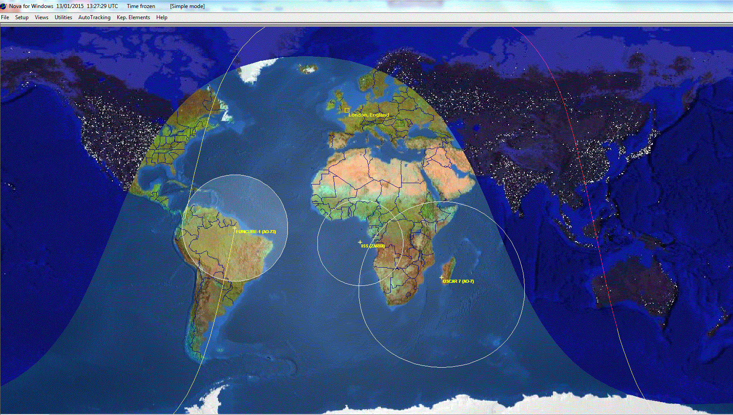
Orbits: AO-7 @ 1500km AO-73 @ 650km ISS @ 400km

Slide 10

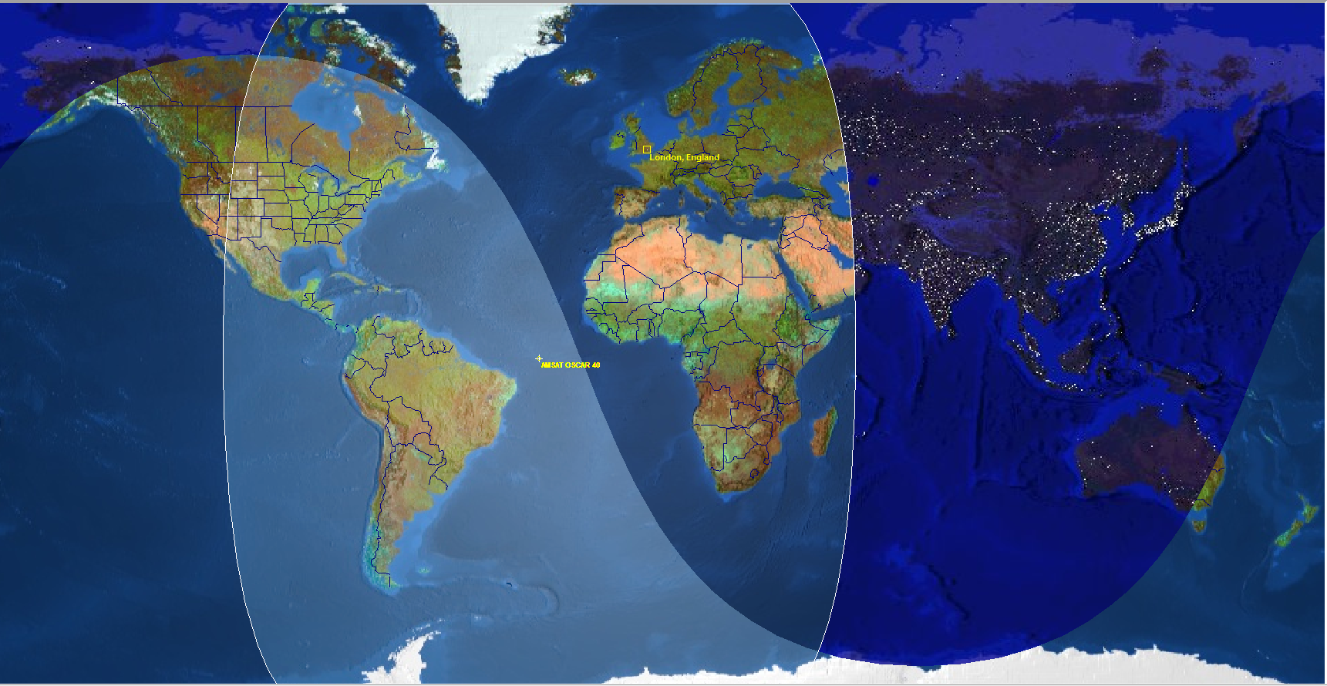
Orbits: AO-40 @ 50,000km (non operational)

Slide 11

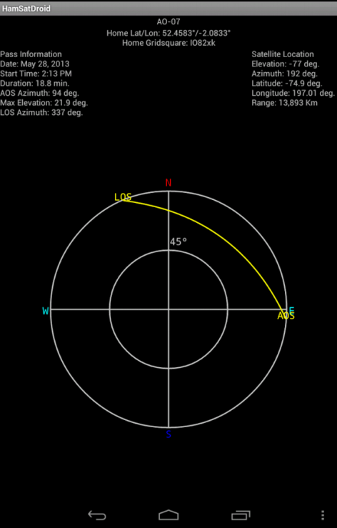
Orbits: Tracking software
AmsatDroid. Free download for android devices. World map + sky view for pointing antennas
Nova for Windows. Free version with limitations or $50
Ham Radio Deluxe. Was free, now? Includes rotator control
SatPC32. From AMSAT-NA tracking + computer control of doppler via radio CAT interface.
Online: N2YO.com Uses your location and google maps for display. Or pass predictions at amsat.org

Slide 12
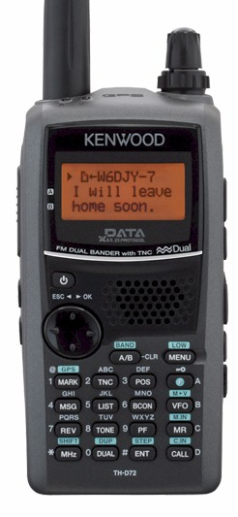
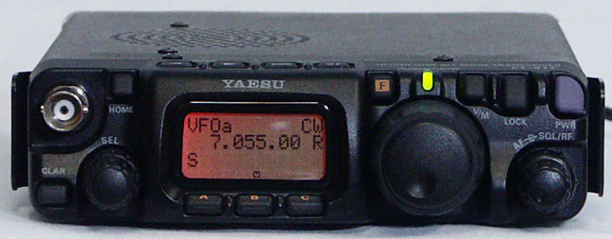
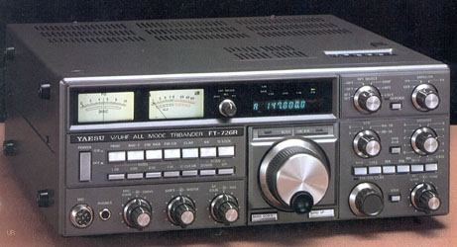
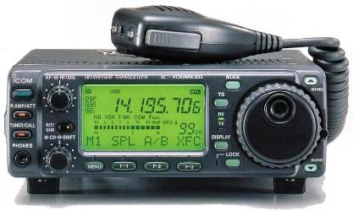
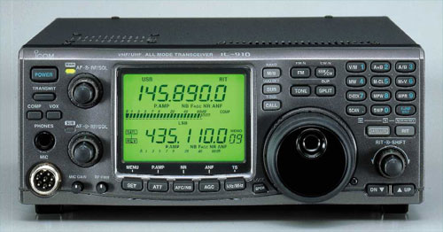
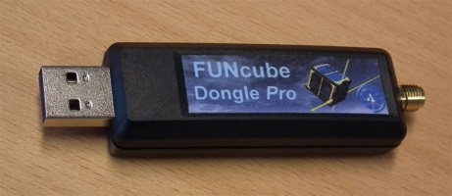
Radios and Antennas
Duplex – transmitting and receiving at the same time. - Is a real advantage
Duplex radios are available but 2 separate radios will work as well.
Handhelds 3 – 5W. Base stations 10 – 50W. Any radio with 2 or 70 can work
Kenwood THD7
Yaesu FT-817
FT736R (duplex)
IC706 - But beware phase noise !
IC910 or 9100 (duplex)
Software Defined Radio

Slide 13

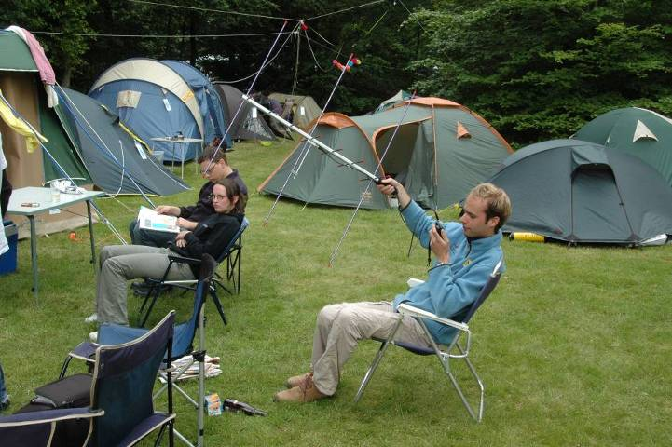
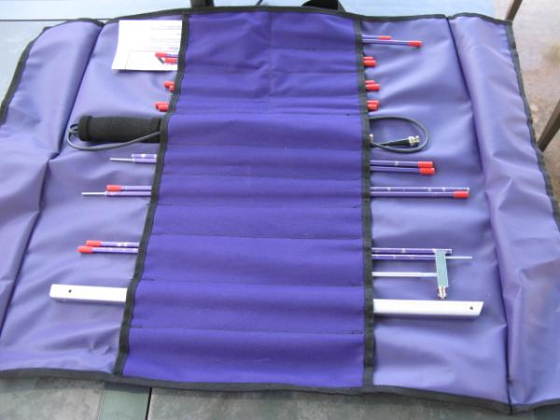
Radios and Antennas
Working satellites in Low Earth Orbit do not require complex antennas, but small beams will perform better than omnis, especially for transmitting.
This is the ARROW portable satellite antenna.
3 elements on 2m + 7 ele on 70cm.
Also available is a diplexer for a single cable feed

Slide 14
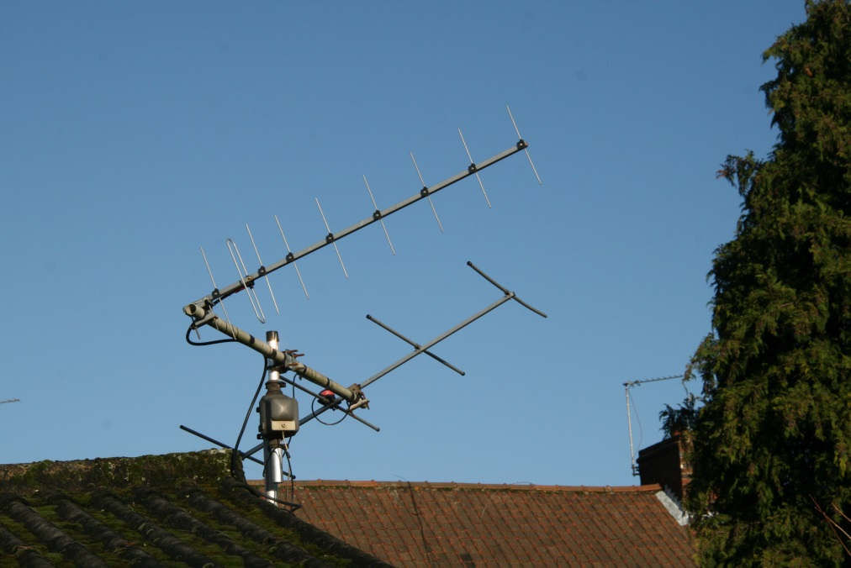
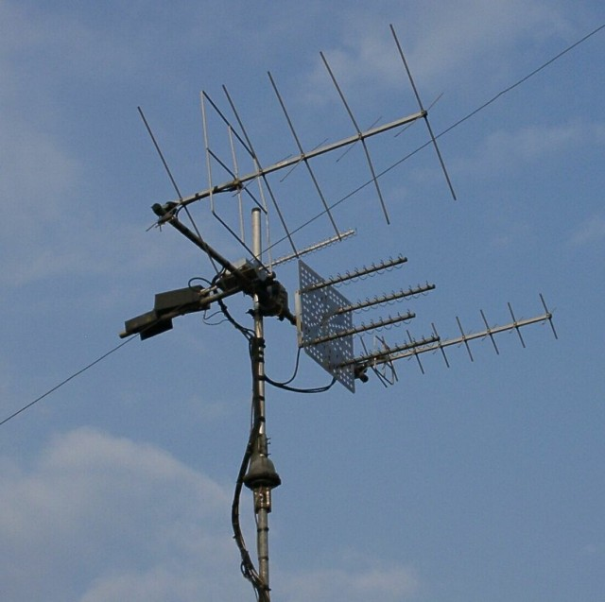
Radios and antennas
Working satellites in low Earth Orbit does not require complex antennas but small beams will perform better than omnis, especially for transmitting.
Antennas at G0MRF
4 elements on 2m + 9 element Tonna on 70cm.
Rotate in azimuth but fixed at 30 degrees elevation.
Still work well for terrestrial QSOs – (Beamwidth)
DD1US: Az/Elevation rotators with 2m / 70cm circular polarised yagis and 4 x helix for 23cm

Slide 15
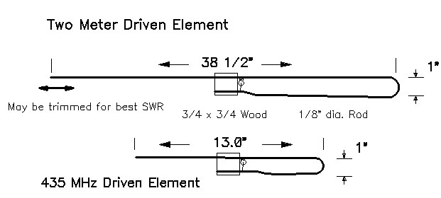
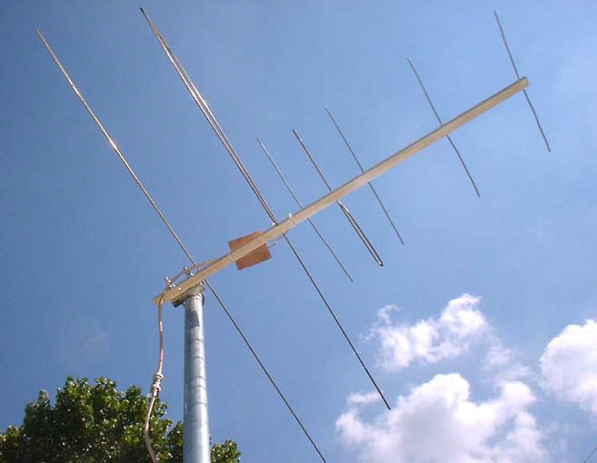
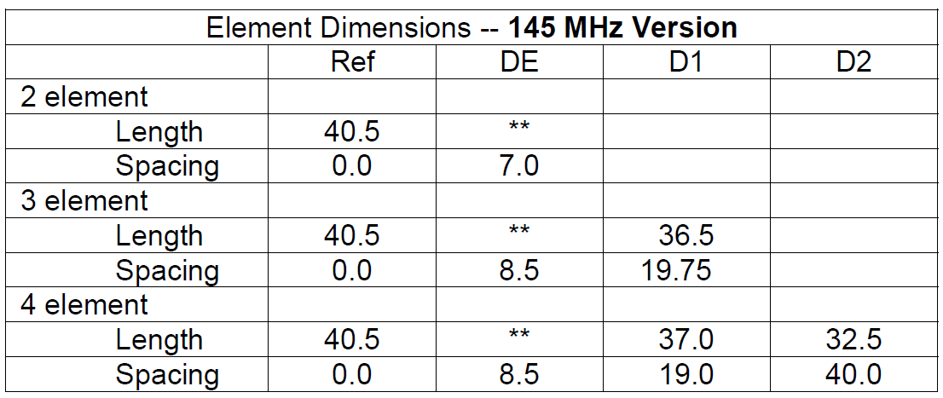
DIY Antennas
An alternative to the commercial $145 Arrow is a DIY version from Kent Britain WA5VJB
http://www.wa5vjb.com/references/Cheap%20Antennas-LEOs.pdf
Notes:
For the UK, a 4 foot broom handle from Homebase at £4.49 is long enough for a 4 element on 2m with 8 elements (offset at 90 degrees) on 70cm.
Elements can be either welding rod – Copper coated steel. Or for the reflector and directors Aluminium filling welding rods. – All available in 1m lengths by the kg from e-bay.

Slide 16
Active satellites for voice communication ( amsat.org for latest )
AO-7 Linear transponder 100kHz 70cm – 2m and 70cm to 29MHz
FO-29 Linear transponder 100kHz wide 2m to 70cm
SO-50 FM repeater single channel 2m up to 70cm down
AO-73 Linear transponder 20kHz wide 70cm up to 2m down. Evenings and weekends
International Space Station Occasionally astronauts use Kenwood FM radio
David Bowman G0MRF

Slide 17
Making a satellite QSO
Typical QSO: - Usually short, as passes are 10-15 minutes. Longer on linear transponders
CQ call: CQ satellite / CQ OSCAR 73 etc
Exchange: Signal Report and usually maidenhead locator. e.g. 57 IO91TK
Power: Use minimum to complete contact. Lower power when short range (overhead)
David Bowman G0MRF

Slide 18
Making a satellite QSO
Typical QSO: - Usually short, as passes are 10-15 minutes. Longer on linear transponders
CQ call: CQ satellite / CQ OSCAR 73 etc
Exchange: Signal Report and usually maidenhead locator. e.g. 57 IO91TK
Power: Use minimum to complete contact. Lower power when short range (overhead)
Procedure e.g. for AO-73
Be prepared. – Know the satellite’s track across the sky + frequencies in advance.
Estimate Doppler correction and set the initial TX and RX frequencies.
Wait until you hear the beacon or transponder before you transmit
Send a short burst of CW dits or carrier and tune the RX to find them
When you find your signal, if clear call CQ or retune to find clear frequency or call someone
As you are making the QSO, keep tuning the transmitter to keep the RX frequency constant
http://amsat-uk.org/beginners/how-to-work-the-ssb-satellites/
David Bowman G0MRF

Slide 19
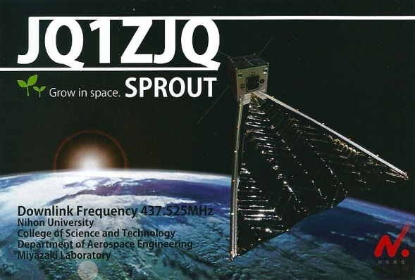
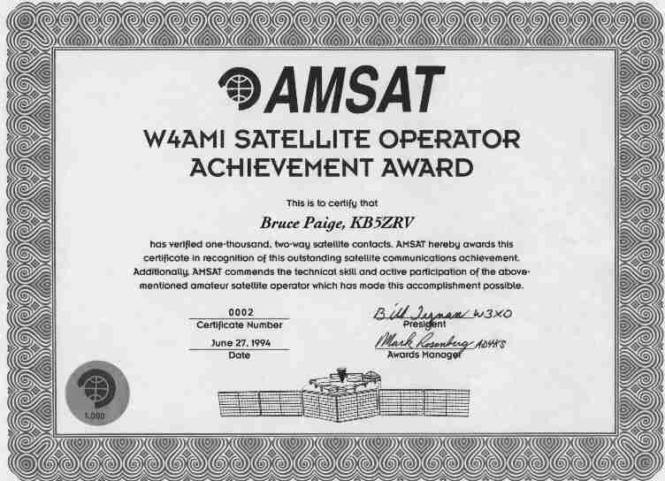
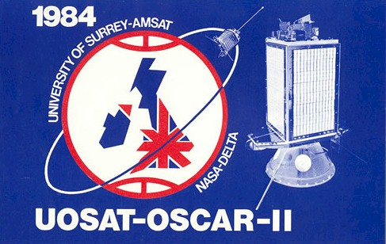

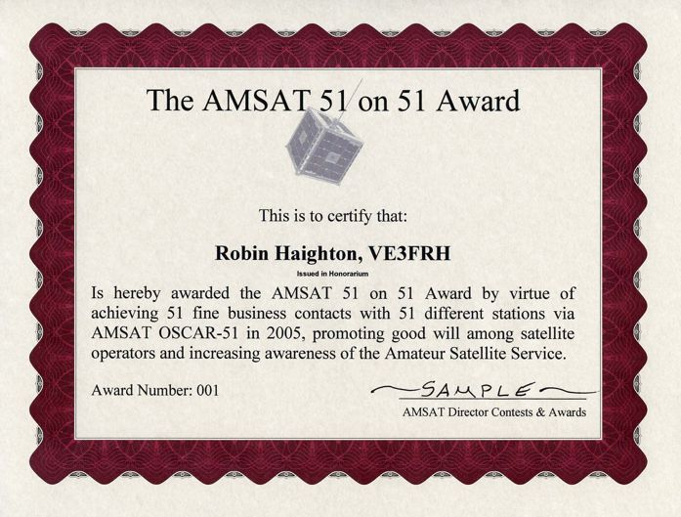
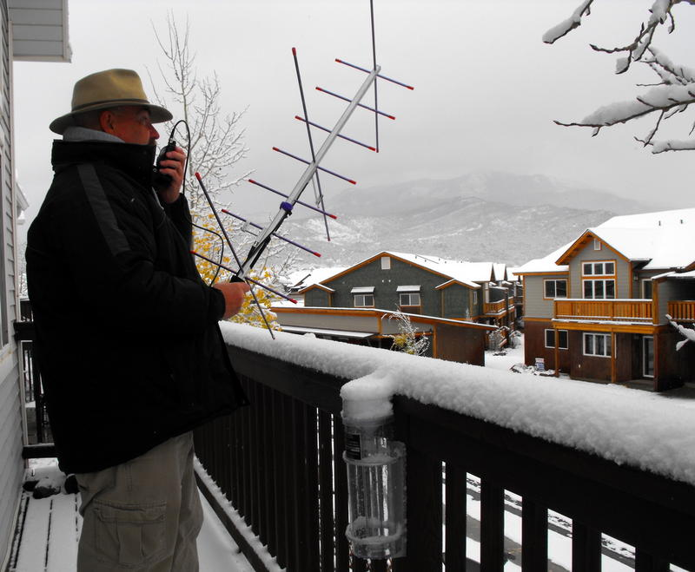
Challenges !
Making your first satellite QSO is always big challenge
There are many DX stations on satellites. – A geostationary sat is due in 2016 / 2017
Awards are issued by AMSAT / Satellite teams and National organisations

Slide 20
Thank You
David Bowman G0MRF

